Slide 1

Predicting Employee Attrition Across Factors Affecting Workplace Behavior and Satisfaction
Gillian Tatreau
Department of Data Science, Bellevue University
DSC630: Predictive Analytics
Professor Andrew Hua
12 August 2023

Slide 2
What is employee attrition?
Employee attrition: when an organization loses an employee and has an outstanding position to fill as a result
Need to reduce attrition by focusing on employee benefits (Wooll 2022)
Estimated average cost of hiring a new employee is $4,000 (Vasconcellos 2023)
Takes most employees 3-6 months to feel that they making positive contribution to organization (Stibitz 2015)

Slide 3
Purpose of predicting employee attrition
Cost of hiring and time dedicated to training
Prepare to hire a replacement or intervene in some way so that employee no longer wishes to leave

Slide 4
Data
Kaggle
Manufactured data created by IBM data scientists

Slide 5
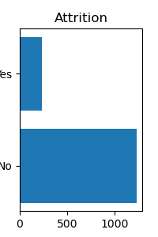
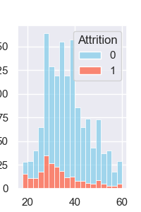
Data Understanding
Unbalanced class weights in target variable
Slightly higher value of attrition for lower age range than seen in overall population

Slide 6
Data Preparation
No missing data or irregular values
Removing irrelevant variables
Converting categorical variables with only two values into 0 or 1
Creating dummy variables for both the categorical and ordinal variables
Standardizing the data

Slide 7
Machine Learning Algorithms
Logistic regression
k-Nearest Neighbors
Decision Tree

Slide 8
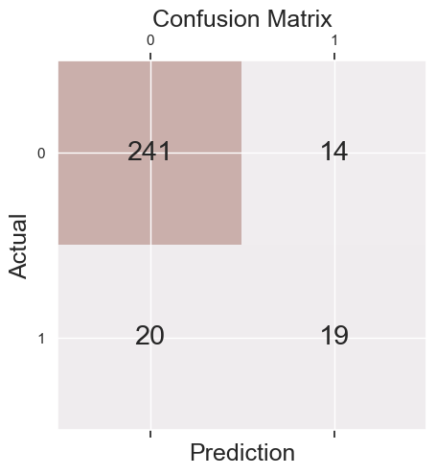
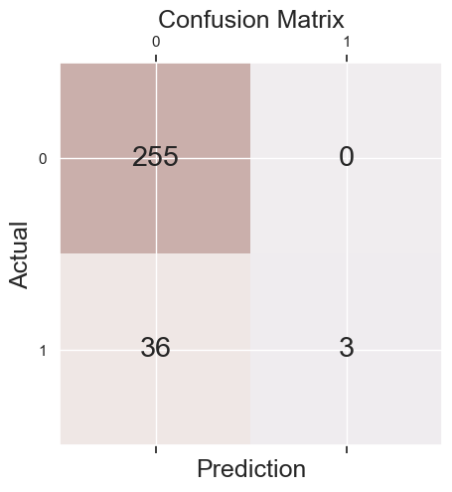
Results
Logistic Regression
K-Nearest Neighbors

Slide 9
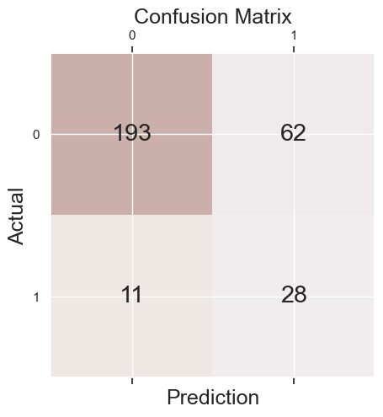
Comparison of Logistic Regression Models with and without up sampling
Without Up Sampling
With Up Sampling

Slide 10
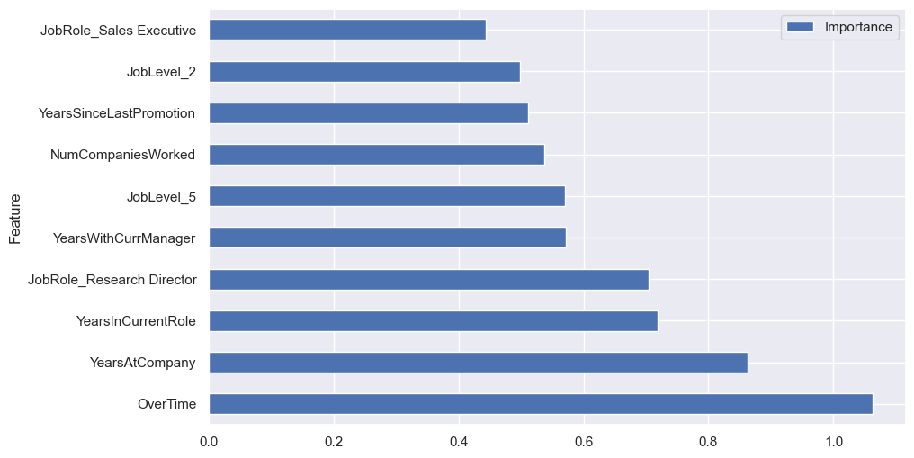
Results: Feature Importance

Slide 11
Conclusion
Important features: OverTime, YearsInCurrentRole, TotalWorkingYears, and YearsSinceLastPromotion
Best model on its own is first logistic regression model
Ensemble model that combines the performance of the logistic regression model with up sampling (highest recall) and the k-Nearest Neighbors model (highest precision and lowest false positive rate)

Slide 12
Ethical Considerations and Recommendations
Information gives company the ability to prepare for when an employee might be leaving their position or to make structural changes that might convince that individual to stay
Most ethical application is to focus on ways that attrition could be prevented by implementing structural changes when possible
Focus only on the features that are identified as the highest predictors of attrition in the model that the organization is able to control
Probability for each class should be considered more carefully than the predicted class itself

Slide 13
References
Employee attrition and factors. Kaggle. (n.d.). https://www.kaggle.com/datasets/thedevastator/employee-attrition-and-factors
Karanth, Manohar. (2020). Tabular summary of HR analytics dataset. [Data set]. Zenodo.
https://doi.org/10.5281/zenodo.4088439
Stibitz, S. (2015, August 12). How to get a new employee up to speed. Harvard Business Review.
https://hbr.org/2015/05/how-to-get-a-new-employee-up-to-speed
Vasconcellos, E. (2023, February 21). How much does it cost to hire an employee?. Business News Daily. https://www.businessnewsdaily.com/16562-cost-of-hiring-an-employee.html
Wooll, M. (2022, January 24). Employee attrition vs. turnover: What’s the difference? BetterUp.
https://www.betterup.com/blog/employee-attrition

